Slide 1
Healthy Eating in the Workplace
Ross McClean
Head of Health & Wellbeing
Notes:
The food we eat directly impacts our health. A healthy diet reduces our risk of chronic diseases such as obesity, diabetes, high blood pressure and heart disease.

Slide 2
National Picture

Slide 3
Unhealthy Weight: Locally
Notes:
According to public health England, Eastleigh experienced a significant decrease in the % of adults with excess weight in the last few years. 62.3% of adults in Eastleigh are deemed overweight or obese. The 2017 data release showed we were at 67%
Compared to our nearest statistical neighbours

Slide 4
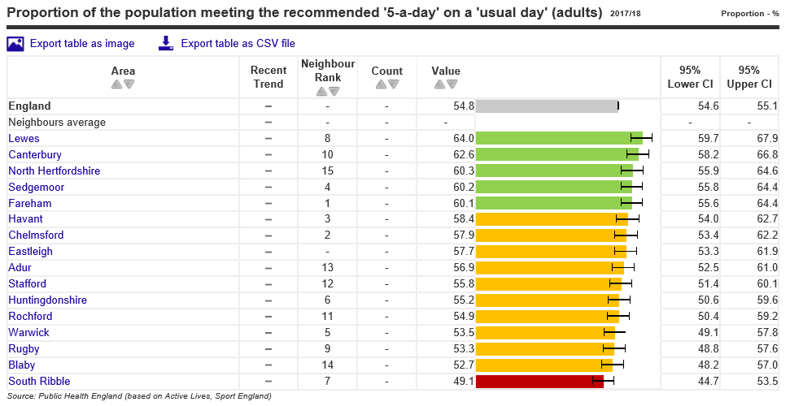
Adults meeting the 5-a-day recommendation

Slide 5
What are we doing to address this issue?
Partnership working with health bodies
Communication campaigns
Healthworks scheme
Weight Watchers (WW) free programme
Notes:
Health and wellbeing board

Slide 6
What can we do to help local business
Work with Public Health to advise on healthy food offers in the workplace
Develop a holistic workplace programme which could include:
Healthy eating advice
Individual health checks and goal setting
Physical activity programme
Develop wellbeing policy in the workplace

Slide 7
Thank you for listening
Any questions?

