Slide 1
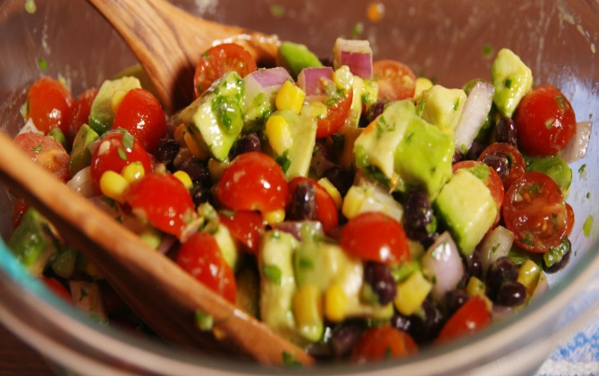
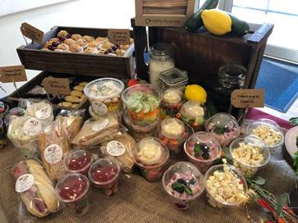
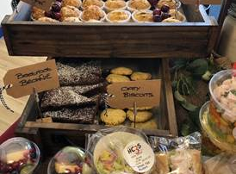
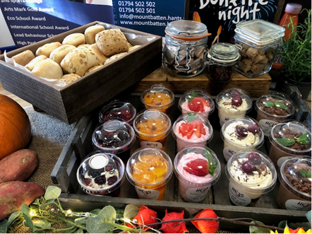
Linda Kennedy Head of Commercial Operations Hampshire County Council Catering Services (HC3S)

Slide 2
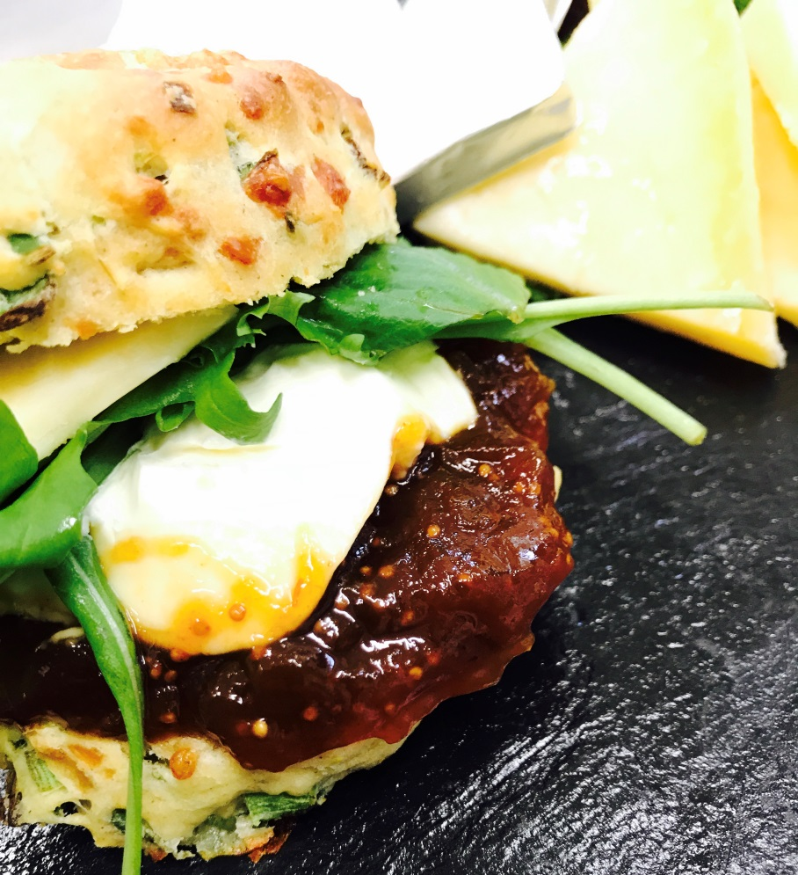
Who are we?
Self funding business unit within HCC
Provide catering services to over 490 schools in Hampshire, Dorset and Wiltshire
Provide catering services to several visitor attractions and business sites

Slide 3
Our Values
Committed to working with customers to promote healthier eating and wellbeing in the workplace
In house work place initiative, Zest for Life, supporting the availability of healthier foods and beverages, making it easier to choose and maintain a healthier diet while at work
83% of dishes prepared and cooked on site
Full traceability and provenance
Focus on local, fresh, seasonal ingredients
Supports ethically produced and scoured products

