Slide 1
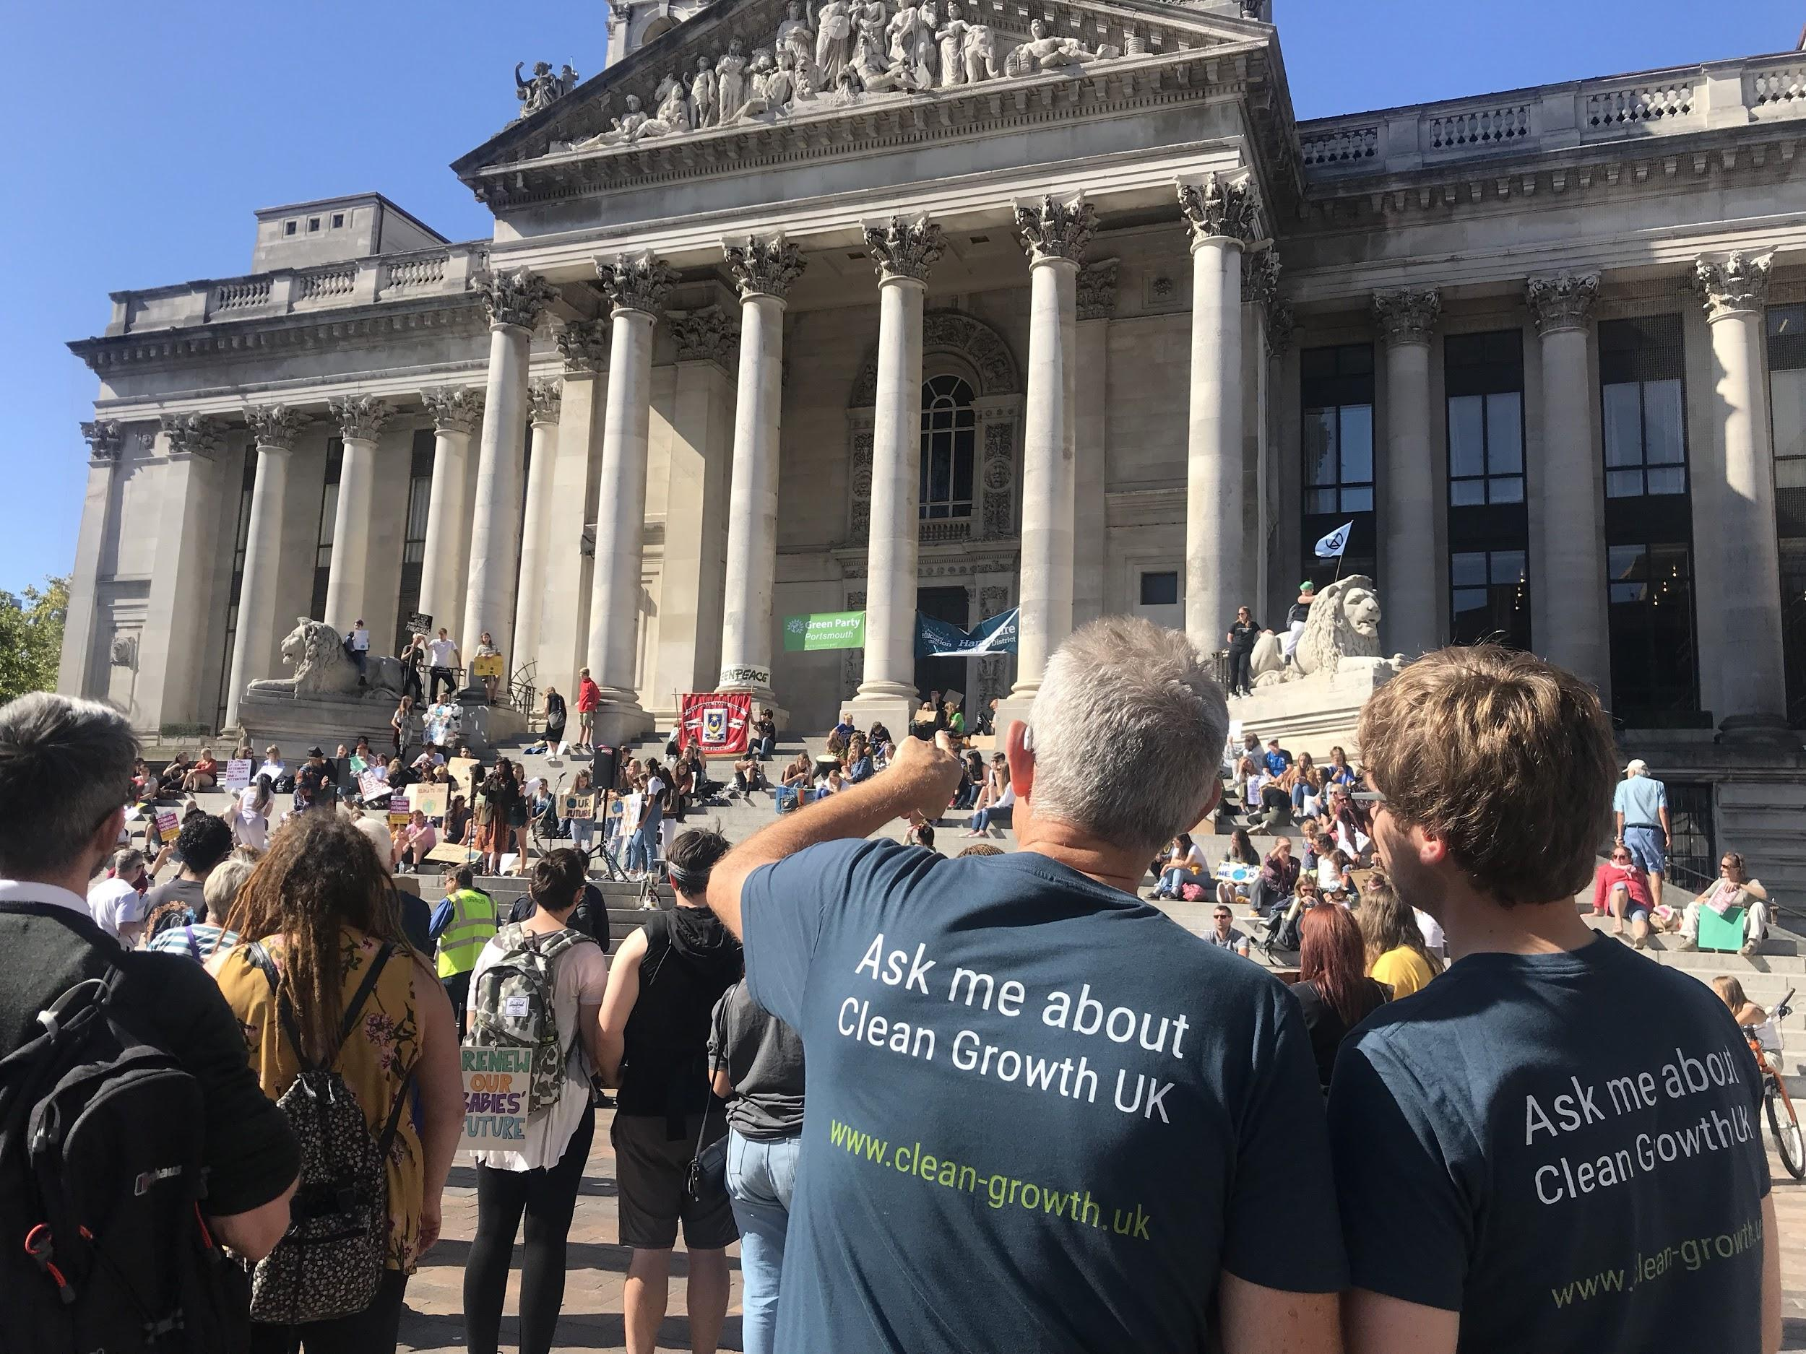
Greentech South
How do we support our clients?
Eastleigh Borough Council Business Breakfast
7th November 2019
Richard Hall
Business Development and Programme Manager at Greentech South

Slide 2
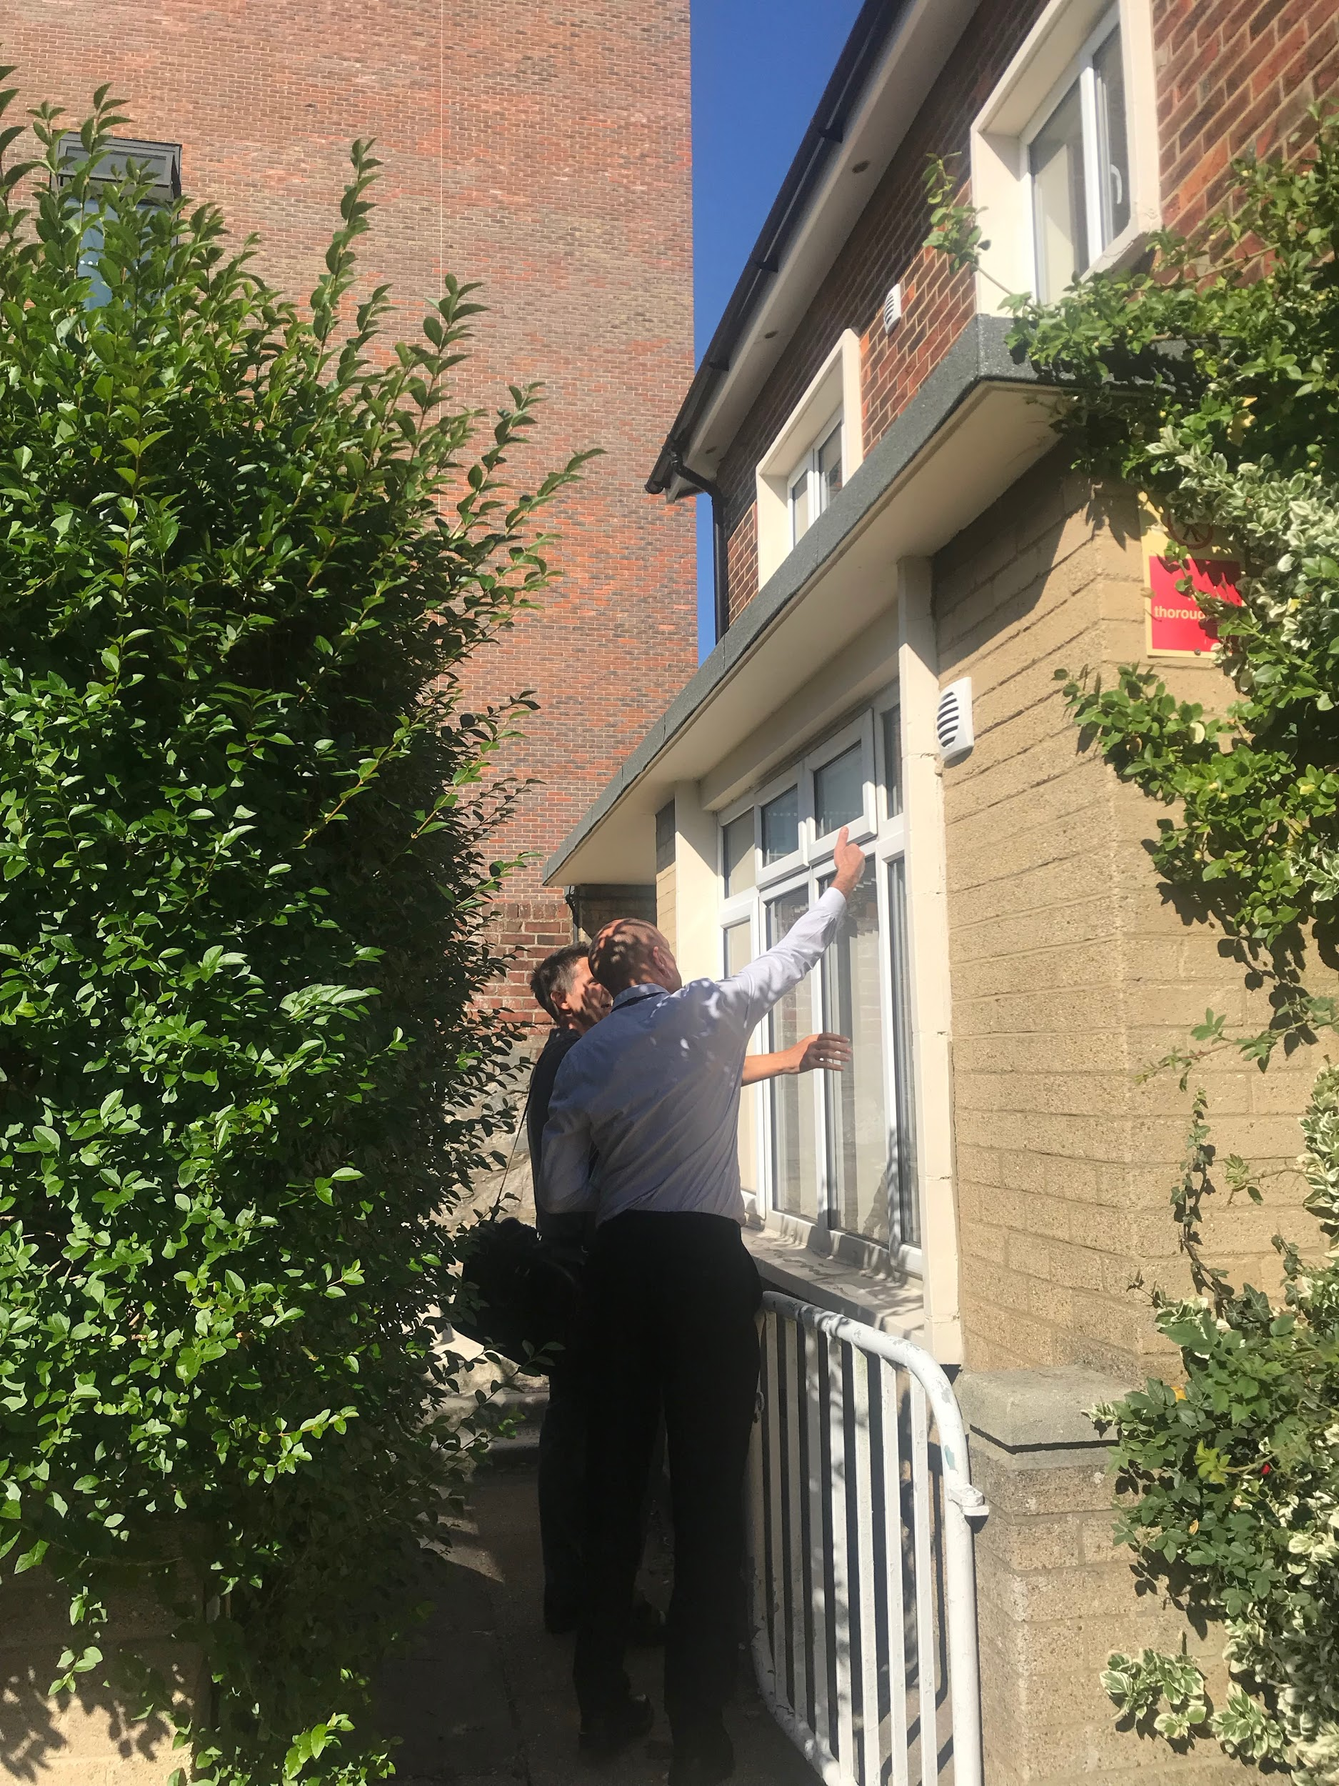
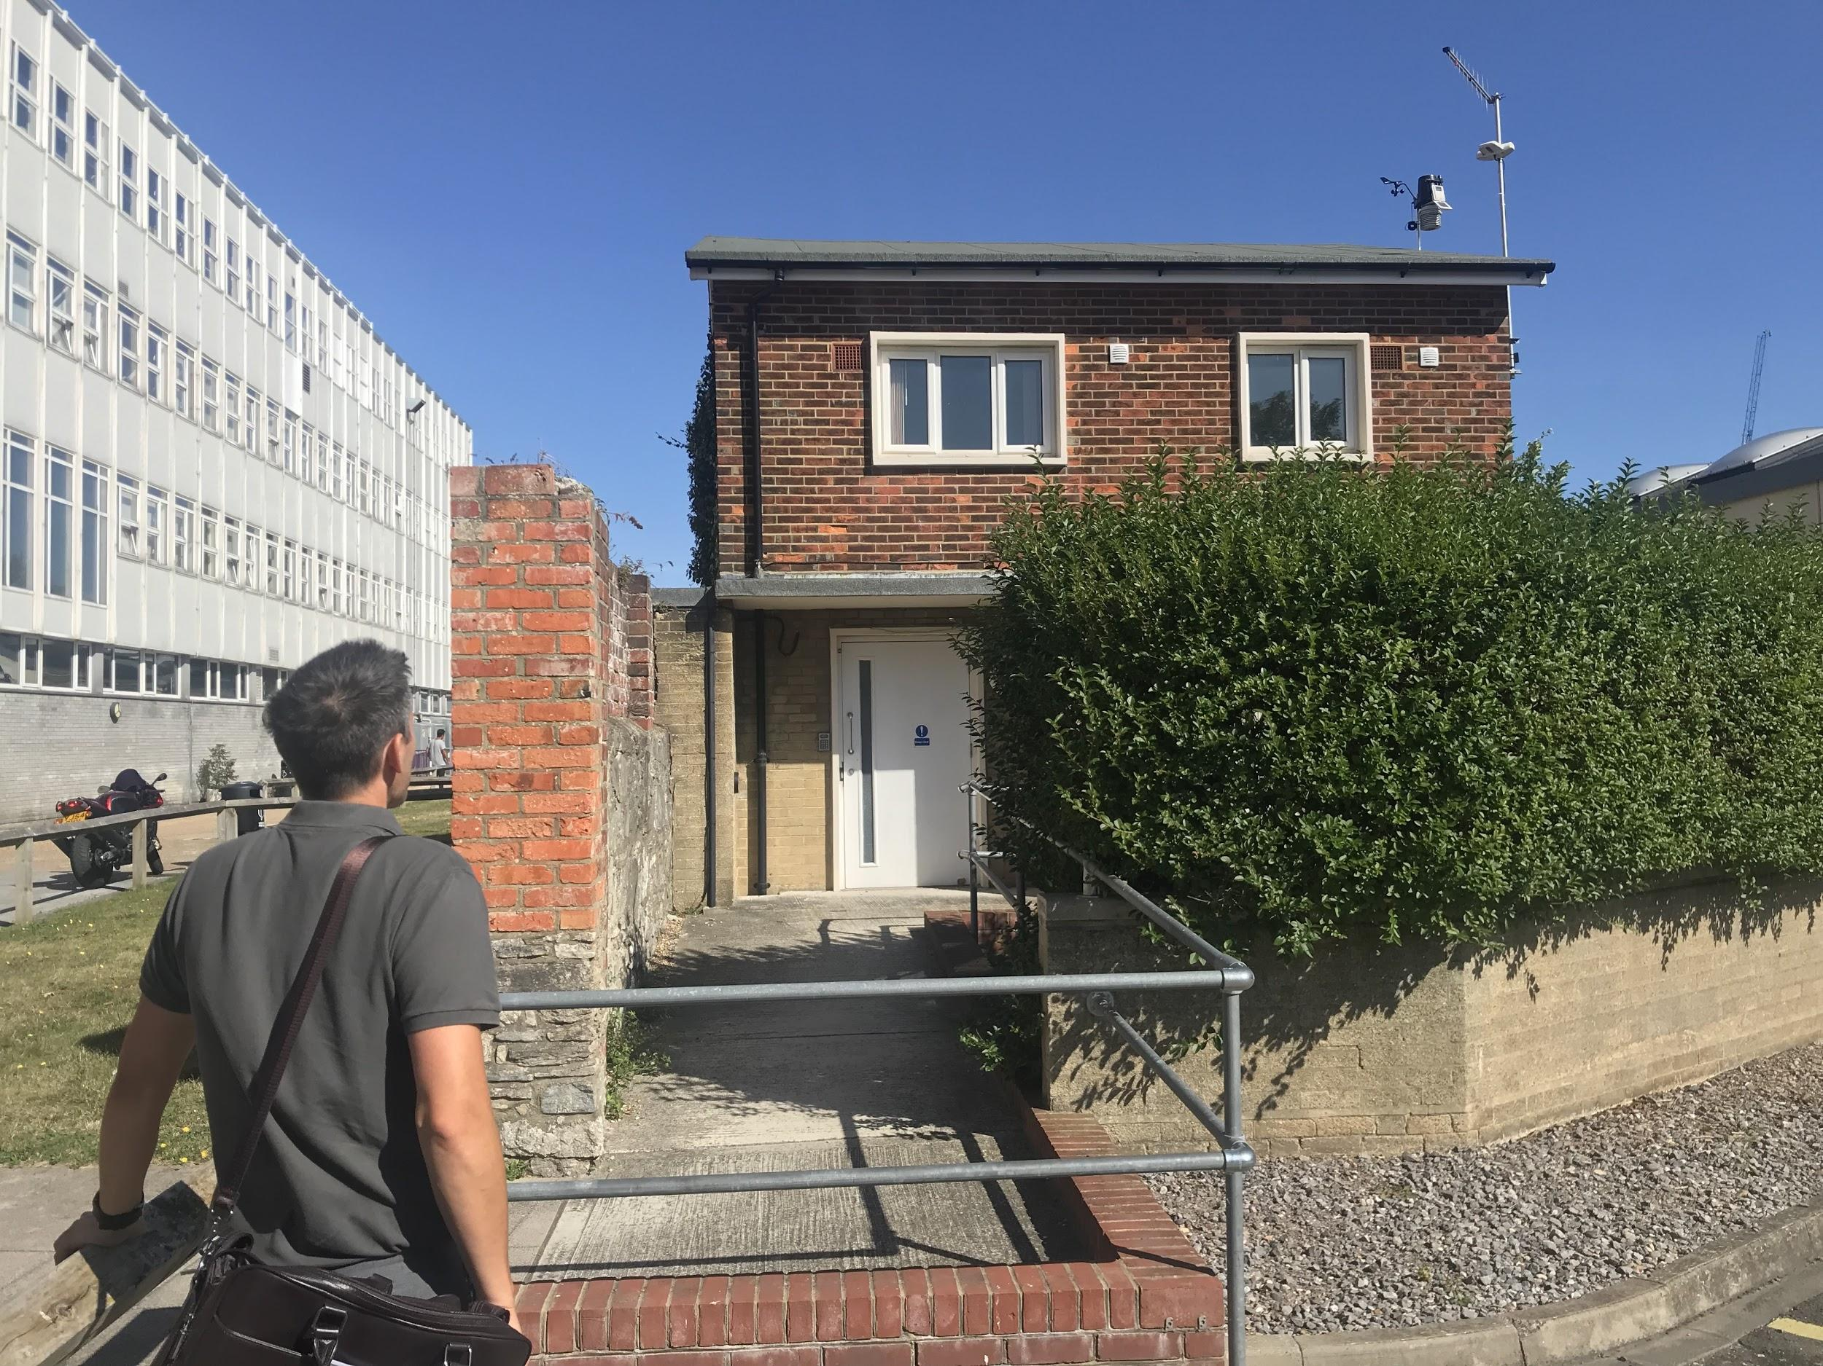
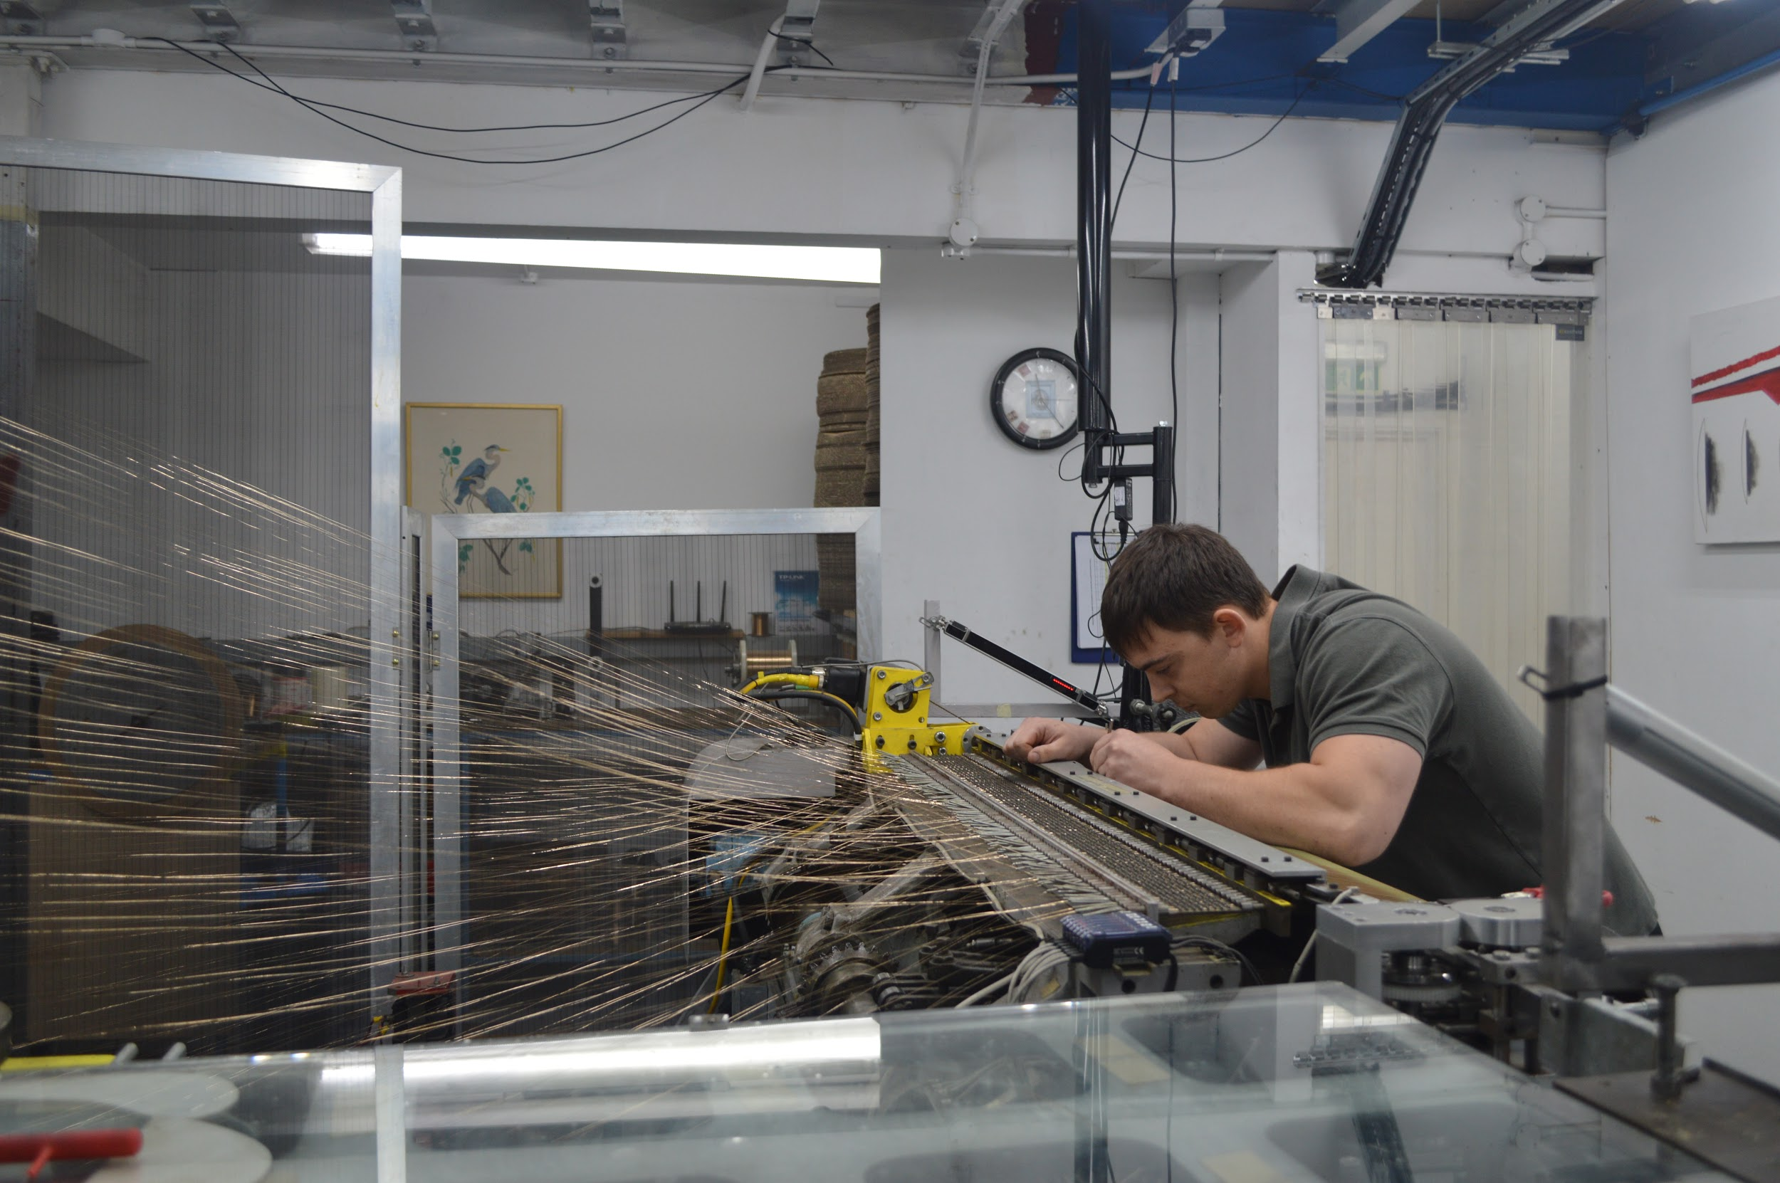
Business Support

Slide 3
Events

Slide 4
Engagement with Academia

Slide 5
International Network
GreenCape

Slide 6
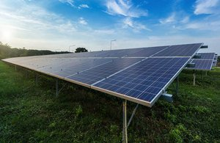
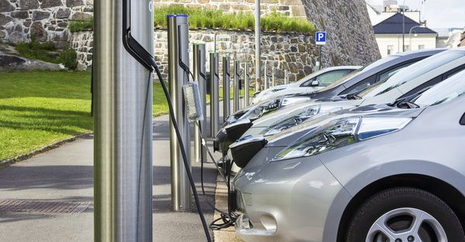
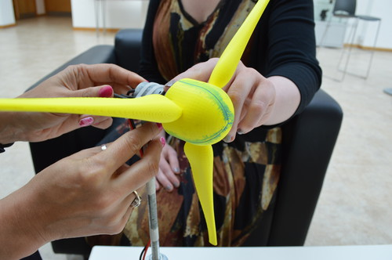
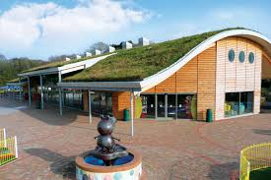
Access to Funding Streams
EMphasis3 CO₂ Project Launches Friday
135 Energy efficiency audits
Grants to purchase “Energy Saving Kit” <£25,000
Grants to Innovate “Low CO₂ Solutions” <£25,000
Coming Soon:
Low Carbon Solent
Plus support in bidding for Innovate UK and any other clean growth fund

Slide 7
June 2019
Mr GreenThumb
Managing Director of Bush ltd
Thank you for listening!
GThumb@Bush.com

