Slide 1
Air Quality Action Plan
Eastleigh Business Breakfast
7th November 2019

Slide 2
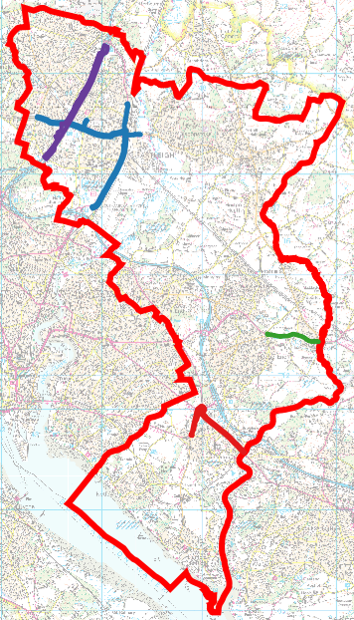
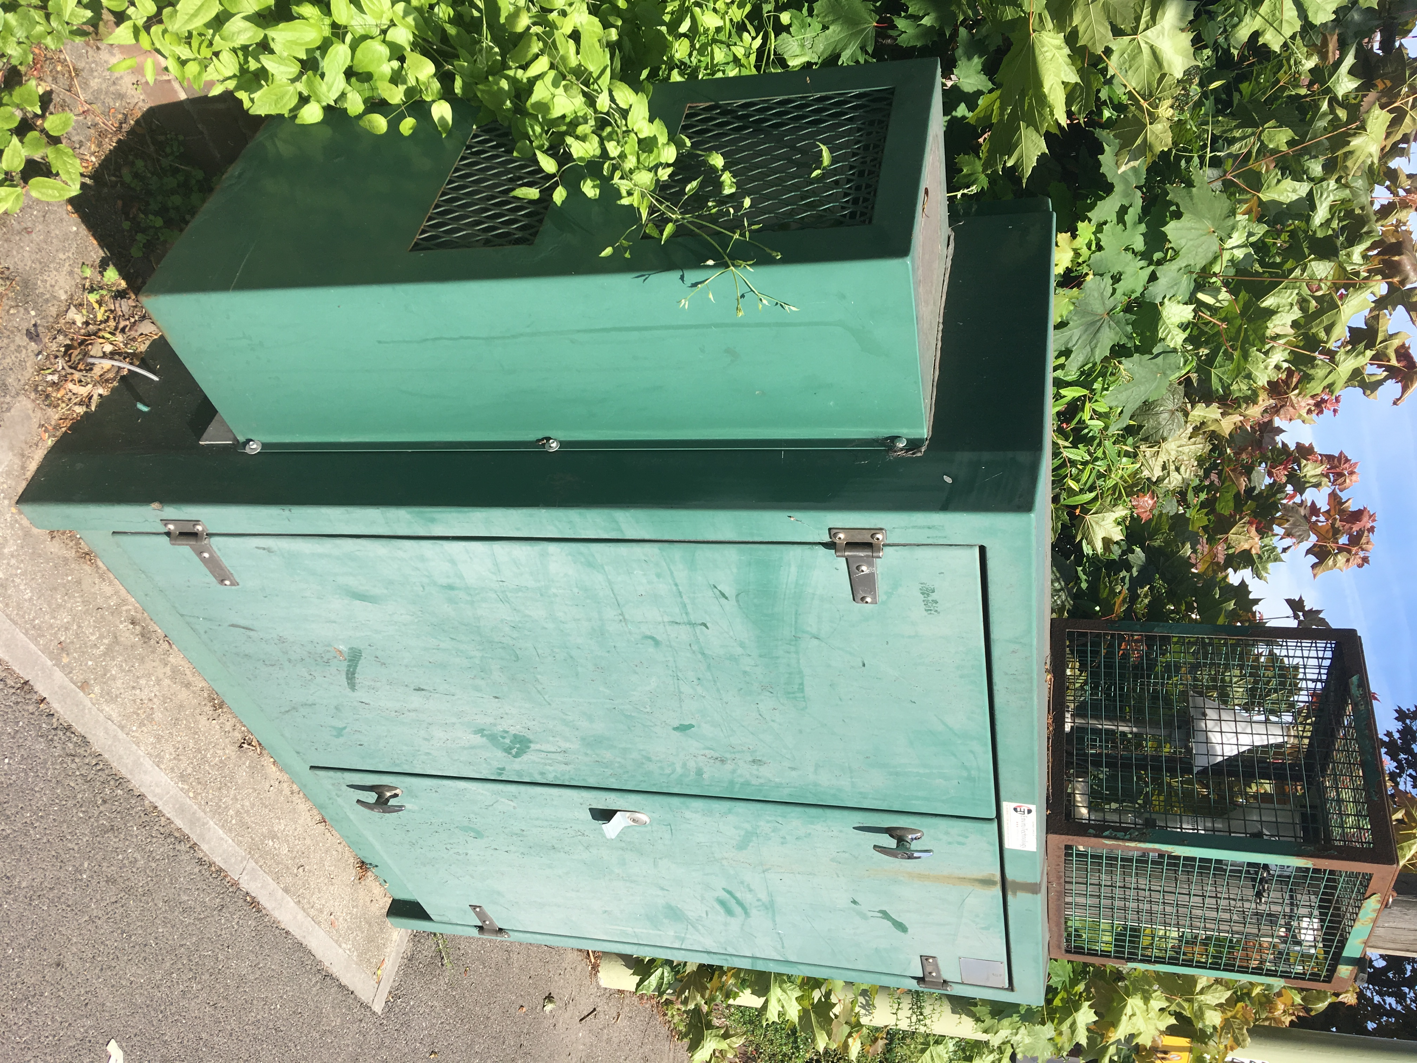
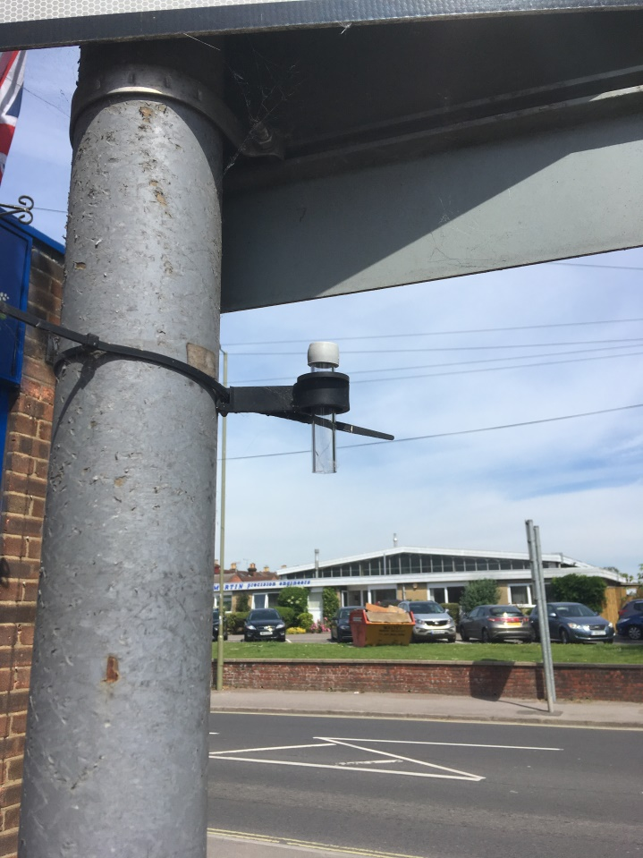
Air Quality Monitoring
Weekday
Weekday
Saturday

Slide 3
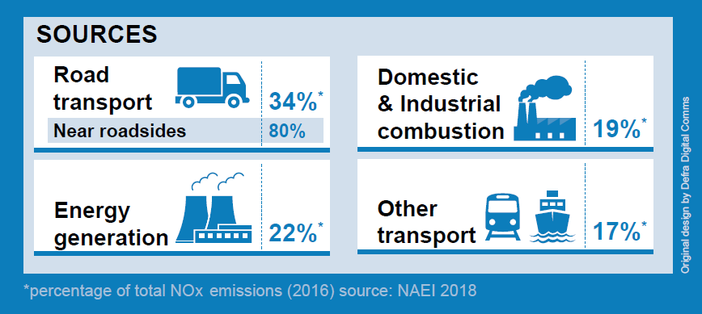
Pollution Sources
Government Clean Air Strategy 2019

Slide 4
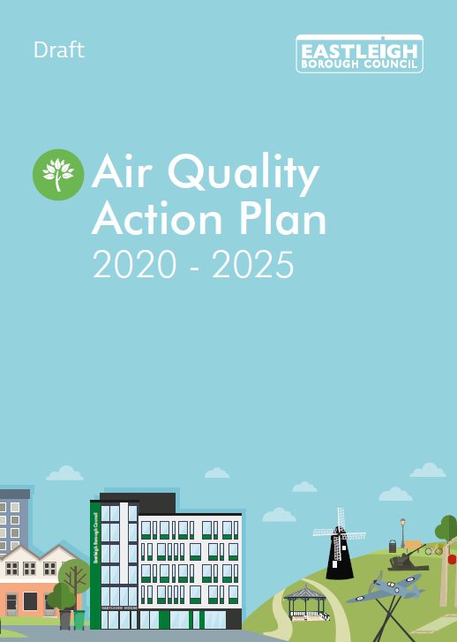
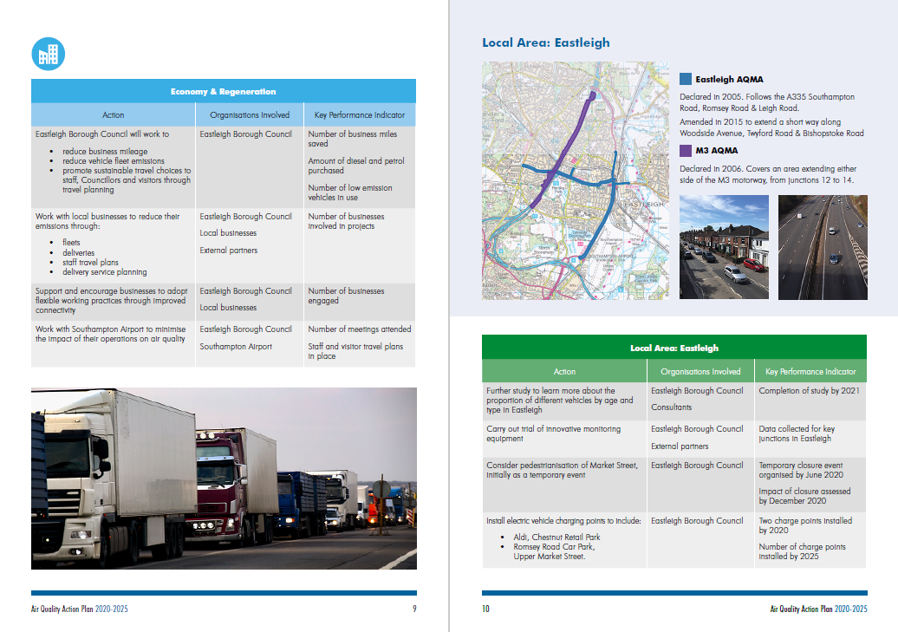
Air Quality Action Plan
Reducing vehicle emissions
Encouraging other methods of travel

Slide 5
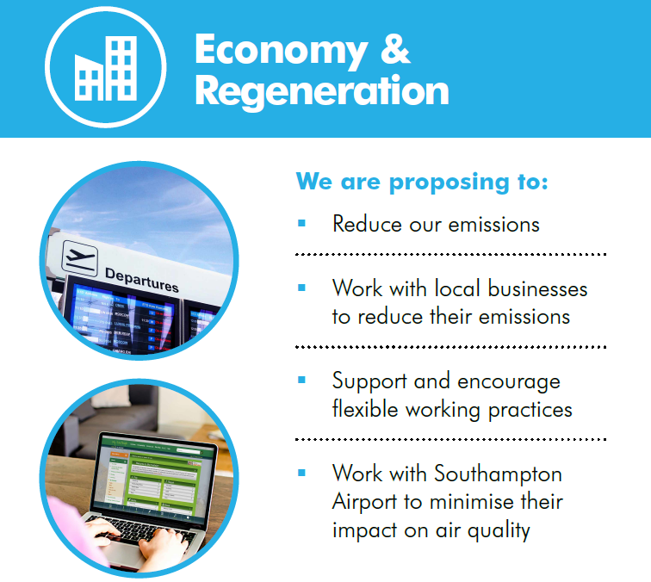
Business Action
Employees
Customers
Deliveries
Fleets

